Slide 1
Introduction to Fair Research Inc.
February 2018
Fair Research Inc.

Slide 2
<Services> ➢Equity Research Fair Research Inc. (FRI) supplies a fresh look at Japanese SME’s with customized equity research and keen insights. ➢Investment Advisory FRI advises on markets, sectors, valuations and risks, based on fundamental research. ➢M&A and Corporate Finance FRI specializes in introducing small and medium size international companies to Japanese acquirers, and vice versa.

Slide 3
<Vision> Fair Research Inc. is a research and advisory firm covering Japanese industries and companies. It conducts unbiased research and fills a gap between business enterprises and investors. While there is a surfeit of superficial information on the internet, reliable information is hard to come by. FRI believes that deep fundamental research should be the basis for decision making in investments and business alliances, including M&A. We help clients to make the correct decision by providing keen insights into industries and companies.

Slide 4
<Why Japan?> 20 Years of deleveraging have strengthened balance sheets
Japanese companies stopped borrowing in the early 1990’s and have since restored their balance sheets while concentrating on core competences for the past 20 years.
（右軸）
(Note) All Industries excluding Finance and Insurance (Source) Financial Statements Statistics of Corporations, MoF

Slide 5
<Why Japan?> Ready for Fresh Development with Abundant Cash
Cash and marketable securities on Japanese balance sheets amount to 210 tril. JPY. This is the ammunition for new business development.
(Note) All Industries excluding Finance and Insurance (Source) Financial Statements Statistics of Corporations, MoF

Slide 6
<Why SMEs?> SME’s Surpass Large Enterprises in Capital Efficiency
SME’s are hungry for growth and efficient in the use of capital.
(Note) All Industries excluding Finance and Insurance (Source) Financial Statements Statistics of Corporations, MoF

Slide 7
<Why SMEs?> SME’s are undervalued
(As of the end January 2018)
There are a lot of SME’s .
TSE1/Large 100
TSE1/Medium 402
TSE1/Small 1554
TSE2/Smaller 518
SME’s are not covered well by analysts and fund managers.
(Source) Japan Exchange Group

Slide 8
<Why Bullish on Japan?> Deja Vu of Continental Europe in the Late 1990’s
 | Germany（Late 1990’s） | Japan（Late 2010’s）
International investor perceptions before reforms | Sick man of Europe (in mid-1990’s) | Japan passing (in early-2010’s)
Corporate management perceptions | Sense of crisis over inefficiency of socialist capitalism | Sense of crisis over Galapagos-style isolation
Corporate attitudes to capital markets | Shareholder value / Focus on IR | Corporate governance / Focus on IR

Slide 9
<Why Bullish in Japan?> Deja Vu in Continental Europe in Late 1990s
 | Germany（Late 1990s） | Japan（Late 2010s）
Domestic Economic Policy | Schroeder Reform ・Lowering corporate income taxes, Abolishment of capital gain taxes on stock transfers by corporates ・Labor market flexibility ・German Corporate Governance Code (2002) ・Assistance for high growth industries | Abenomics ・Lowering corporate income taxes, Reduction of capital gain taxes on stock transfers by corporates ・Stewardship Code ・Corporate Governance Code ・Fiduciary Duty Code ・Assistance for venture businesses
Foreign Economic Policy | Monetary Union | TPP
Industry Reorganization | Increase in M&A | Increase in M&A

Slide 10
<Team> Tsuyoshi Suzuki, Managing Director Over 32 years of experience in the financial services industry in Japan, including senior management positions at Toyota Asset Management (as CIO), APS Asset Management (Singapore based boutique, as CEO & CIO in Japan), Asahi Life Asset Management (as Chief Fund Manager) and Citi Global Asset Management (as Senior Portfolio Manager) for over two decades. Served as a senior strategist of Nomura Research Institute in the early 1990’s. Tsuyoshi has a B.A. in Economics from the University of Tokyo. He is a Certified International Investment Analyst and a Chartered Member of the Securities Analysts Association of Japan. Shuichi Seo, CFA, Managing Director Shuichi Seo has a broad experience in research, consulting and business development on global equities. He started his career as a research analyst with Nomura Research Institute in 1984, taking charge of credit analysis of Asian semi-sovereign issuers, research on Australian equities (in Sydney), the formulation of investment strategies at Nomura Investment Management and research on European equities (in London). Following Nomura, Shuichi served at Mitsubishi Asset Brains Co. in 2002, Nikko Asset Management in 2005 and T&D Asset Management in 2011 to conduct research and business development. He was also involved in advisory services on M&A and corporate finance at IBS Securities from 2007 to 2011. Shuichi is a CFA charter holder and served as President of CFA Society Japan from 2013 to 2015. He has a BA in Law from the University of Tokyo and an MBA from Stern School of Management of New York University.

Slide 11
James Hegarty, Senior Adviser James is a long time resident of Japan. After graduating from a British university he received a scholarship from the Japanese government to study at the graduate school of the University of Tokyo in Japan and has been here for most of the intervening period. Much of that time has been spent in the Japanese investment industry, as a researcher and fund manager, in companies such as Barclays, Invesco and Amundi. At Fair Research James will be providing his language skills and investment experience.

Slide 12
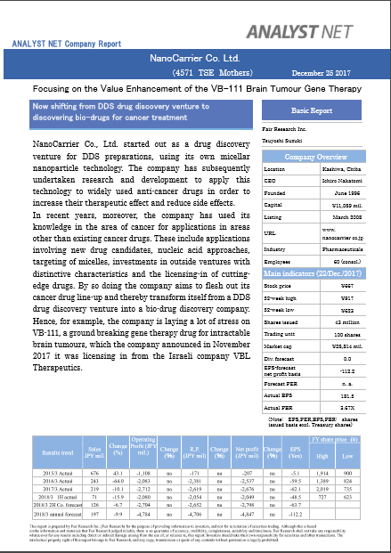
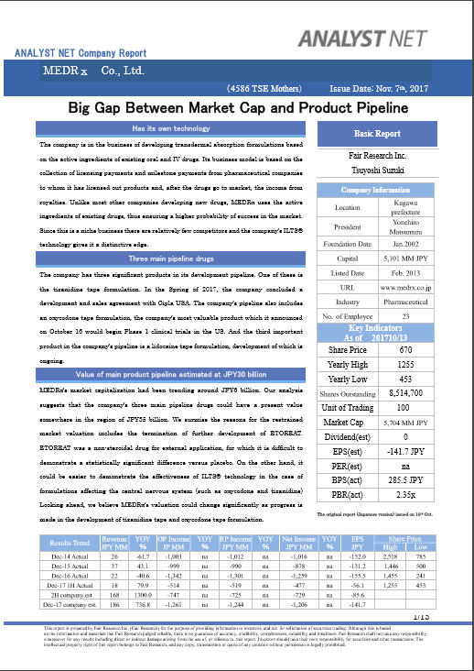
Sample Equity Research Reports

Slide 13
<Contact> Fair Research Inc. AI Bldg. Kayabacho 511, 1-6-12 Shinkawa Chuo-ku Tokyo 104-0033 JAPAN Tel： +81-(0)3-6403-9217 Tsuyoshi Suzuki, Managing Director E-mail: tsuzuki@fair-research-inst.jp Shuichi Seo, CFA, Managing Director E-mail: seo@fair-research-inst.jp Cell : +81-(0)80-3553-9889

